Slide 1
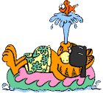
KEEPING IT FUN
Arvel McElroy
785-218-1912

Slide 2
The purpose of this session is to:

Slide 3
provide you with some ideas for keeping workouts fun
Provide you with some ideas for teambuilding
give you the opportunity to share ideas with other coaches

Slide 4
This is a participation session and a “take home” session.

Slide 5
Make It Interesting
Lap after Lap
Day after Day
Can lead to boredom and reduce performance and focus

Slide 6
Have Fun … Be Creative… Mix it up
Use your imagination…beg, borrow or “steal” ideas from others

Slide 7
Specialty Workouts
For Special Days in the Season

Slide 8
The 12 Days of Christmas
Patterned after the song
9100 yard workout for those who finish it all.
Option to drop out after Day 11.

Slide 9
T-shirt Examples
Those that finish the entire workout earn the honor of wearing a special t-shirt.

Slide 10
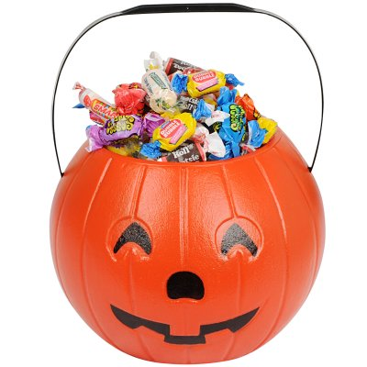
Grab Bag Workout
Swimmers and divers draw slips of paper from a Christmas stocking or other “container”
Whatever task is drawn must be done
Mix of “fun stuff” and challenges

Slide 11
Greeting Card Workout
Written by the swimmers and divers for a teammate
Parameters set by coaching staff
Any holiday card will do
We do it over winter break and for St. Patrick’s Day

Slide 12
Candy Cane (or any other candy) Relays
Workout session after warm-up consists totally of relay races
Winners of each relay race earn candy canes (or other candy)

Slide 13
Stotan Week
Stotan Contract
Specialty workouts like in the book
Swimmers read the book
Special certificates/shirts at end of week

Slide 14
PI Day
Held on March 14 (Spring Season for girls)
Take PI out to 15 decimal places with each set being determined by the place value (to 15th place as hundreds equals 8000 yards)
Earn the right to wear a special t-shirt if you complete the entire workout

Slide 15
Countdown to Championships
Post number of days left until championships (conference, regionals, state) each day
Focus on getting work done now for later

Slide 16
Specialty Taper Countdown
Behind the 8 Ball
Lucky Seven
The Three Musketeers (All for One and One for All)
FOURtitude
Five Card Stud

Slide 17
Special Days for your program?
What SPECIAL days occur during your season? Use the calendar to identify those special days.

Slide 18
Time to Create and Share
Create the framework for a specialty workout for your team.
Share with a partner.

Slide 19
Circuit Day
Opportunity to use the equipment
The swimmers love the “toys”

Slide 20
Dartboard Workout
Magnetic Dartboard
6 darts
Each area of the board is 1000 yard set
Bull’s Eye wins a trip home after warm-up

Slide 21
Variation
For USRPT use 3-4 darts to determine their Improvement Sets for the day.

Slide 22
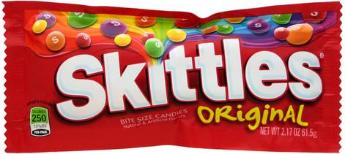
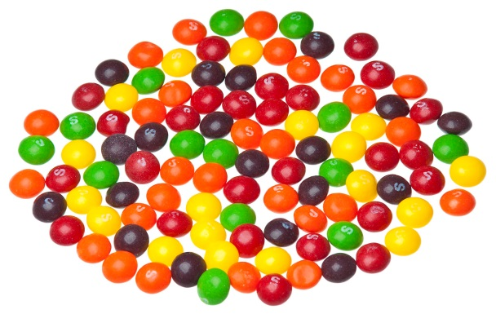
Skittles Workout
Workout set determined by the color of Skittle you draw.
Eat the remainder of the package for “quick energy”.

Slide 23
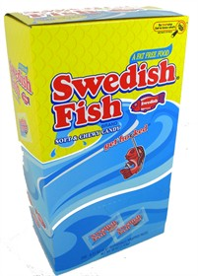
Circus Peanuts and Swedish Fish
Quick energy
Like feeding the animals at the zoo

Slide 24
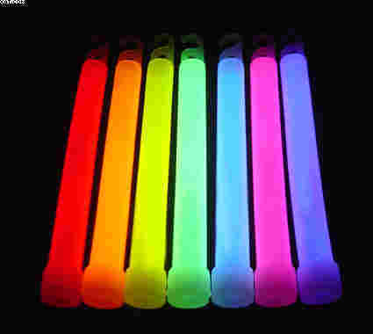
Swimming in the Dark
Glow sticks on ends of pool
Glow bracelets on hands

Slide 25
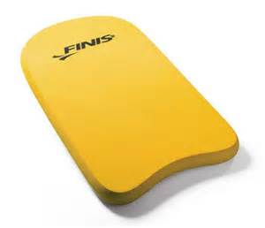
Stop and Go Kicking
Coach or swimmer determines when to “stop” and when to “go” on the kick set
Stop means easy kicking
Set a time limit for the set
Mix up the times

Slide 26
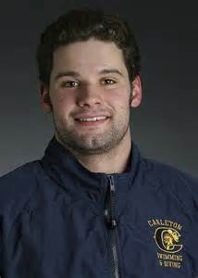
Hour of Power
NISCA sponsored program
One hour of endless relay swimming
Swimmers make decisions and lead

Slide 27
50’s to Failure and 100’s to Success
Send-off chart for 50’s
Swim until you miss an interval
Repeat 100’s working for perfection – slow, fast, etc.

Slide 28
Random Numbers
Pick random numbers → number of repeats in a set or move to that lane, etc.

Slide 29
Disney Day
My girls love to listen to music during practice.
They request at least one “Disney” day each year for Disney movie music so they can sing along.

Slide 30
Trivia Games
Not a “set” or “workout” but keeps them mentally sharp.
Throw out a trivia question or riddle and have them think while swimming.
Can do teams for scores, awards, etc.

Slide 31
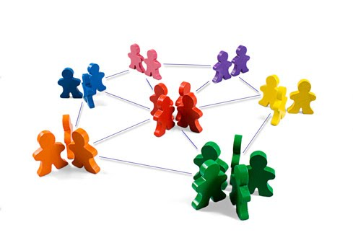
Time to Create and Share
Brainstorm ideas for special workouts in small groups of 3-4.
Make sure to keep records of the ideas others share.

Slide 32
Share as a Group
Each group will share an idea or two for specialty workouts.

Slide 33
Teambuilding Ideas

Slide 34
Scavenger Hunt
Team divided up so new members are matched with returning members.
Teams use their phones to take pictures of various items, activities, and challenges.
Points awarded as per their instructions.
We do it the first Friday of the season.

Slide 35
Camera Activity
Athletes draw the name of a teammate.
During the season they secretly take pictures of this person.
They prepare a “surprise” for the person to be presented at the pasta dinner before championships.
Members reflect on the accomplishments of the person.

Slide 36
Lock-in
An evening or overnight or an all day thing
Plan teambuilding activities i.e. Water Polo, the Box, or the Human Knot
Hold early in the season

Slide 37
Captain or Senior Retreat
Overnight retreat
Focus on Leadership and Planning
Have them help plan activities for the upcoming season
Train them to be leaders

Slide 38
Reading For Success
Divide team into “book groups”
Have each group read a motivational book
Share what was learned with the entire team

Slide 39
Reading For Success Booklist
Stotan
Swimming to Antarctica
Six Days to Swim
The Boys in the Boat

Slide 40
Movie Night
Gather the team together to watch a motivational movie together.
Discuss the movie afterwards

Slide 41
Movie Night Films I’ve Used Over the Years
Miracle
Cool Runnings
Chariots of Fire

Slide 42
Group Discussion
What teambuilding activities have you found to be successful?

